Slide 1
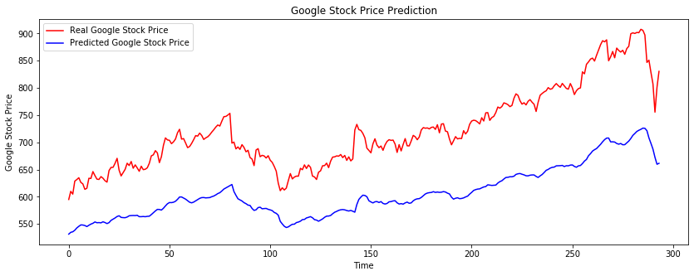
RNN
TOTAL TIME - 936 sec

Slide 2
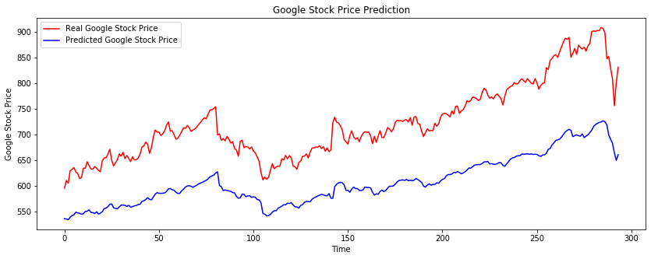
BIDIRECTIONAL RNN
TOTAL TIME - 1235 sec

Slide 3
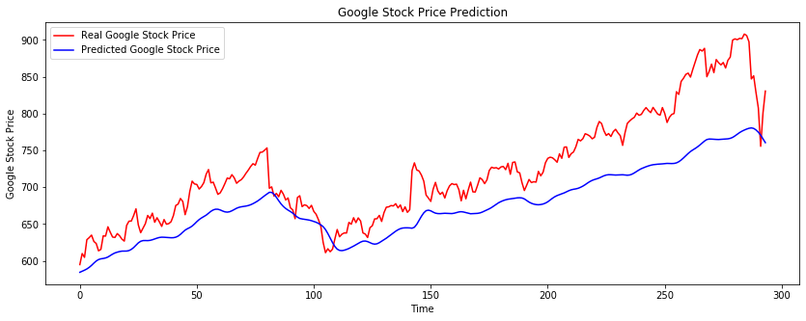
LSTM-MAX
TOTAL TIME - sec

Slide 4
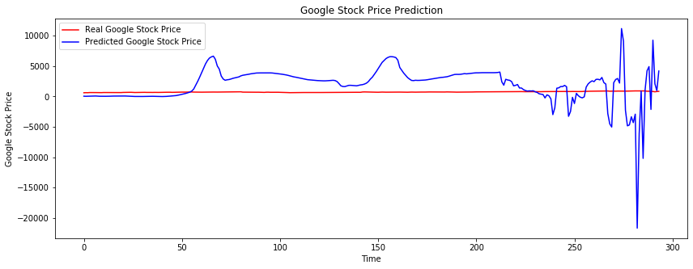
BIDIRECTIONAL-LSTM-1

Slide 5
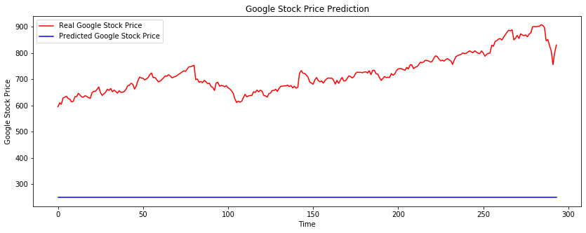
BIDIRECTIONAL-LSTM-2
TOTAL TIME - 3135 sec

Slide 6
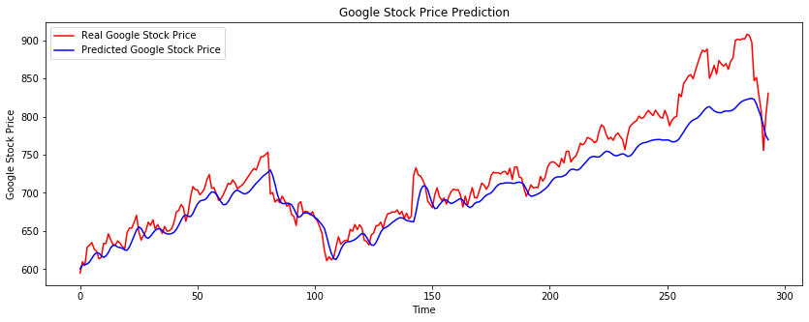
CUDNNLSTM
TOTAL TIME - 51 sec

Slide 7
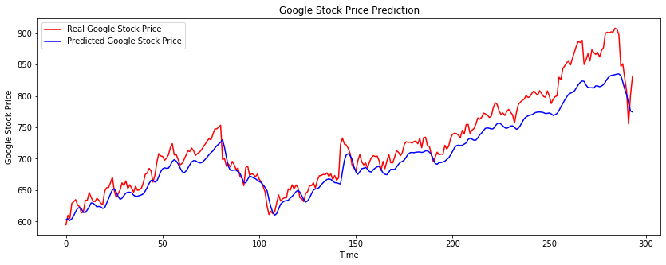
BIDIRECTIONAL-CUDNNLSTM
TOTAL TIME - 101 sec

Slide 8
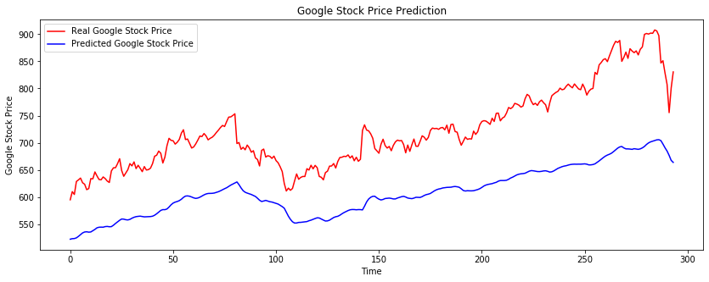
GRU
TOTAL TIME - sec

Slide 9
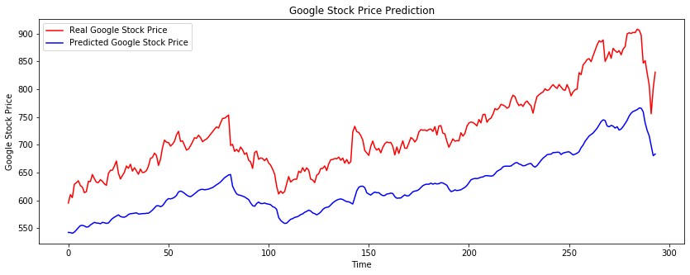
BIDIRECTIONAL-GRU
TOTAL TIME - 2565 sec

Slide 10
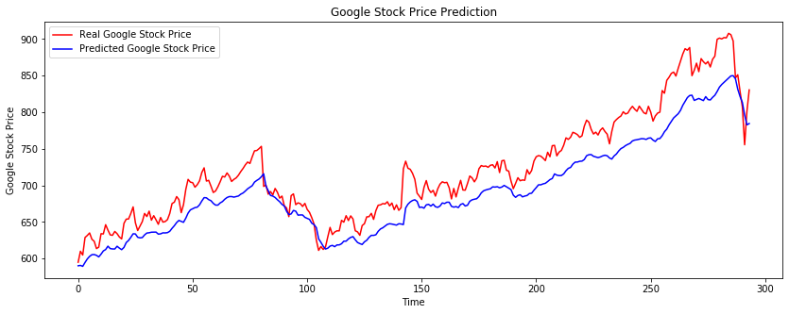
CUDNNGRU
TOTAL TIME - 51 sec

Slide 11
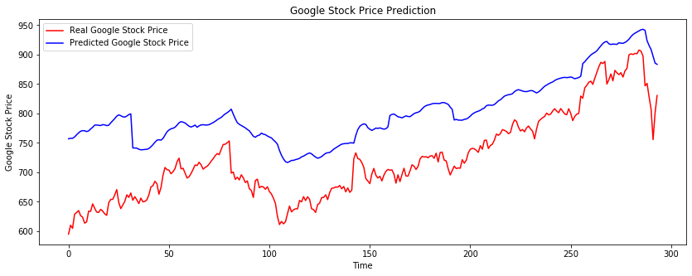
BIDIRECTIONAL-CUDNNGRU
TOTAL TIME - 102 sec

